Slide 1

Mind-Blowing and Mind-Reading Deep Learning
W251 – Deep Learning in the Cloud and at the Edge

Slide 2
Why reconstructing images is a hard problem
Lack of reliable information on how brains work
High level of noise in the signals
Shortage of data
Computational costs
How to measure “success”

Slide 3
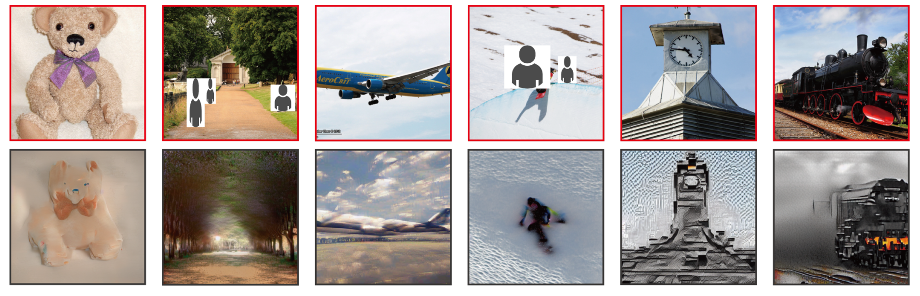
High-resolution image reconstruction with latent diffusion models from human brain activity
Takagi, Yu & Nishimoto, Shinji. (2022). High-resolution image reconstruction with latent diffusion models from human brain activity. 10.1101/2022.11.18.517004.
Notes:
A new method based on a diffusion model (DM) to reconstruct images from human brain activity obtained via functional magnetic resonance imaging (fMRI) termed Stable Diffusion has been proposed by researchers. They rely on a latent diffusion model (LDM) termed Stable Diffusion. The researchers found that they could reconstruct high-resolution and highly accurate images from brain activity by using the popular Stable Diffusion image generation model¹².

Slide 4
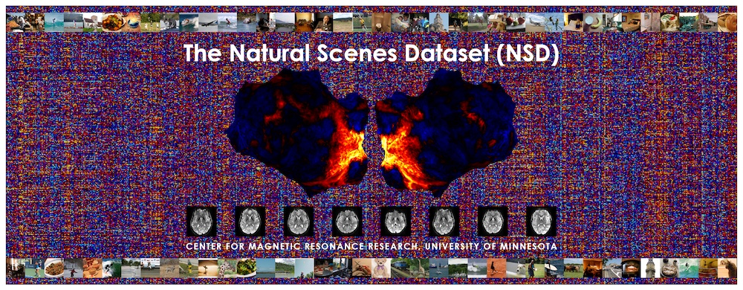
http://naturalscenesdataset.org/
Allen, E.J., St-Yves, G., Wu, Y., Breedlove, J.L., Prince, J.S., Dowdle, L.T., Nau, M., Caron, B., Pestilli, F., Charest, I., Hutchinson, J.B., Naselaris, T.*, Kay, K.* A massive 7T fMRI dataset to bridge cognitive neuroscience and artificial intelligence. Nature Neuroscience (2021).
Notes:
The Natural Scenes Dataset (NSD) is a large-scale fMRI dataset conducted at ultra-high-field (7T) strength at the Center of Magnetic Resonance Research (CMRR) at the University of Minnesota. The dataset consists of whole-brain, high-resolution (1.8-mm isotropic, 1.6-s sampling rate) fMRI measurements of 8 healthy adult subjects while they viewed thousands of color natural scenes over the course of 30–40 scan sessions. While viewing these images, subjects were engaged in a continuous recognition task in which they reported whether they had seen each given image at any point in the experiment. These data constitute a massive benchmark dataset for computational models of visual representation and cognition, and can support a wide range of scientific inquiry.

Slide 5
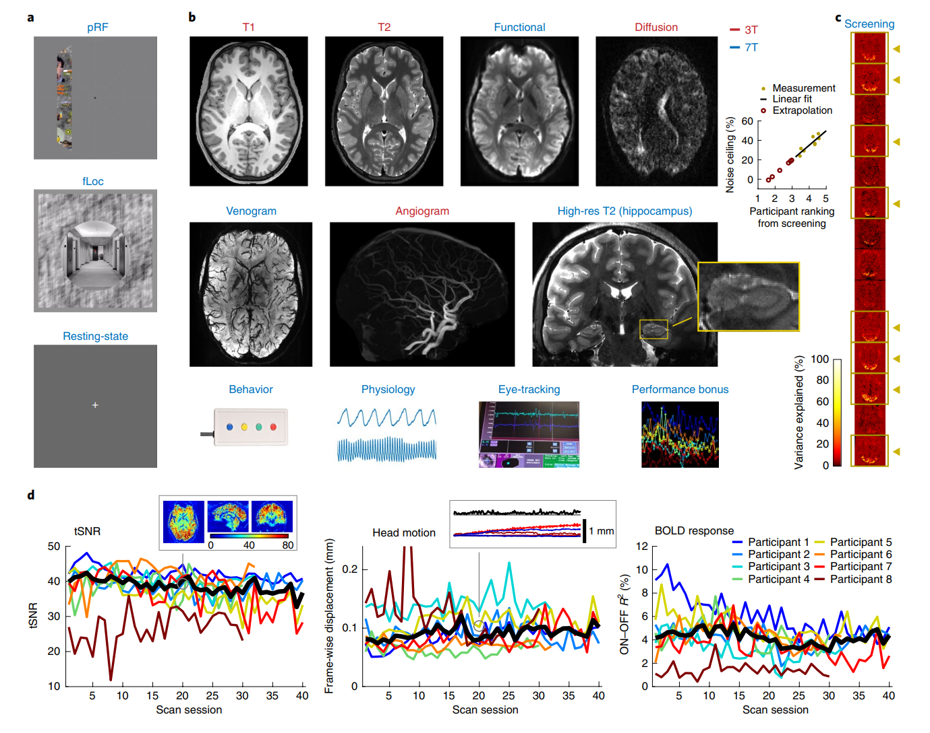
Overview of acquired data - NSD
The images used in the NSD experiments were retrieved from MS COCO and cropped to 425 ⇥ 425 (if needed).
Allen, E.J., et.al. A massive 7T fMRI dataset to bridge cognitive neuroscience and artificial intelligence. Nature Neuroscience (2021).
Notes:
Auxiliary fMRI experiments. Data from the pRF and fLoc experiments were used to define retinotopic visual areas and category-selective regions, respectively. Resting-state data were collected before and after the NSD runs in a subset of the NSD core sessions (totaling 100 or 180 min per participant). b, Available measures. Examples of the actual data are depicted. c, Participant selection. Data quality from the initial screening session was used to rank a set of 14 participants. On the right is an illustration of one measure contributing to the ranking—specifically, variance explained in the fLoc experiment (one slice per participant; identical color range). The inset compares the participant ranking against the b3 noise ceiling calculated on the full NSD dataset. A line fit to the eight NSD participants (gold dots) is extrapolated to predict noise ceilings for the individuals who were not selected for participation in the NSD (red circles). d, Metrics of data quality (for details, see ‘Data quality metrics’ in the Methods). Results for individual participants (thin colored lines) and the median across participants (thick black line) are shown. The insets show detail on tSNR and head motion for one sample run

Slide 6
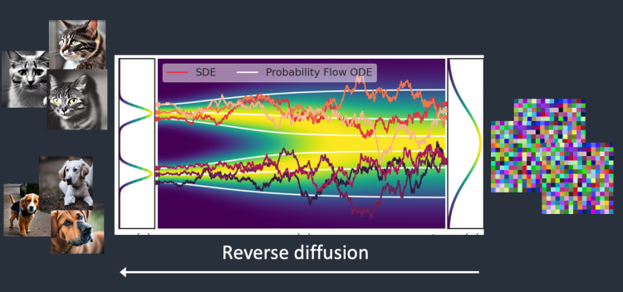
Stable Diffusion
https://github.com/CompVis/stable-diffusion
Forward Diffusion
Song, Yang, Jascha Narain Sohl-Dickstein, Diederik P. Kingma, Abhishek Kumar, Stefano Ermon and Ben Poole. “Score-Based Generative Modeling through Stochastic Differential Equations.” ArXiv abs/2011.13456 (2020).
Notes:
Stochastic Differential equations, ordinary differential equations

Slide 7
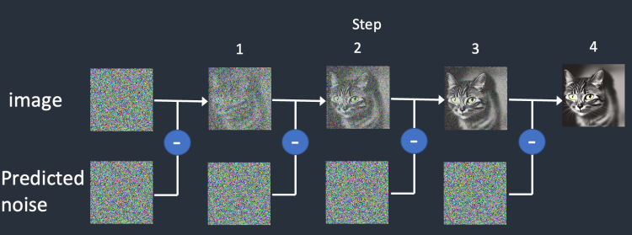
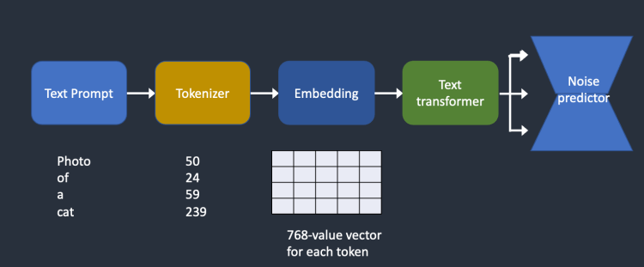
Stable Diffusion
Song, Yang, Jascha Narain Sohl-Dickstein, Diederik P. Kingma, Abhishek Kumar, Stefano Ermon and Ben Poole. “Score-Based Generative Modeling through Stochastic Differential Equations.” ArXiv abs/2011.13456 (2020).

Slide 8
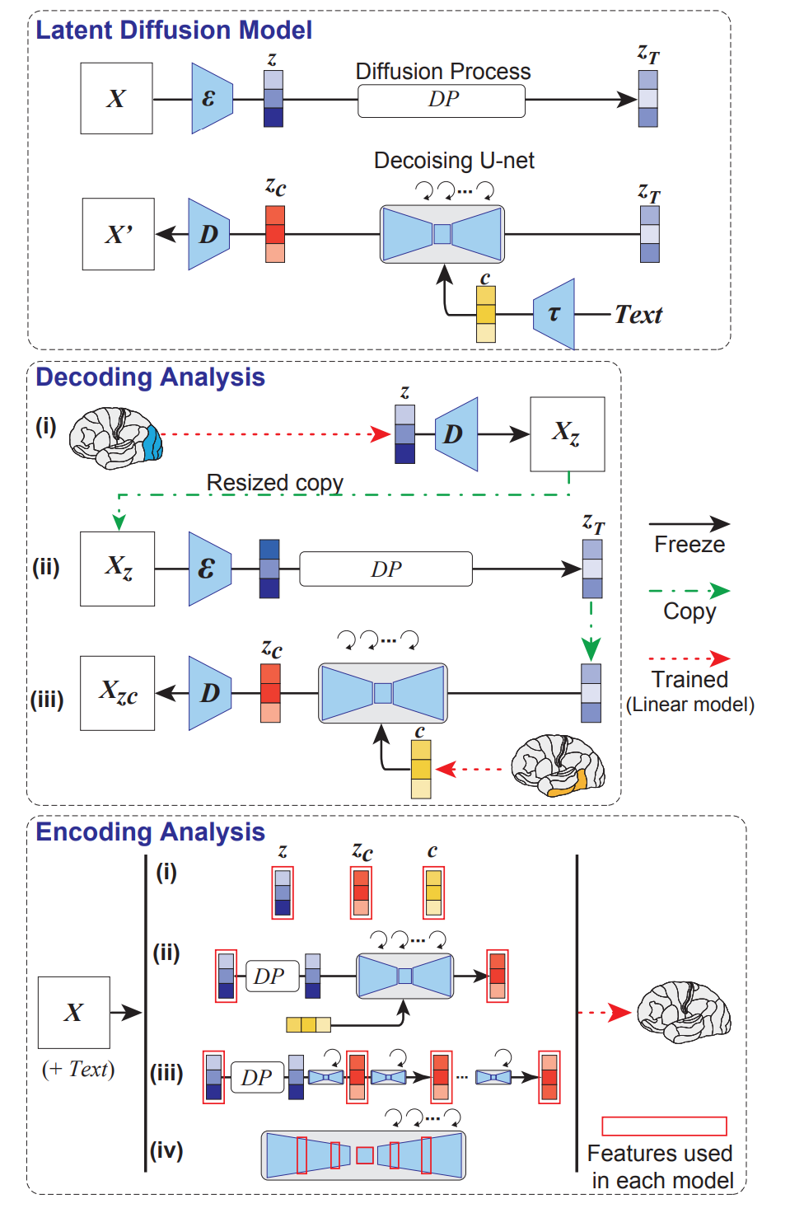
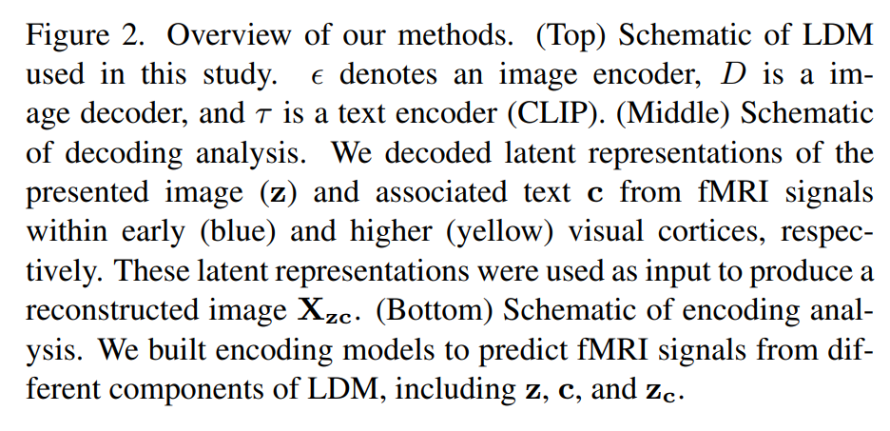
Takagi, Yu & Nishimoto, Shinji. (2022). High-resolution image reconstruction with latent diffusion models from human brain activity. 10.1101/2022.11.18.517004.

Slide 9
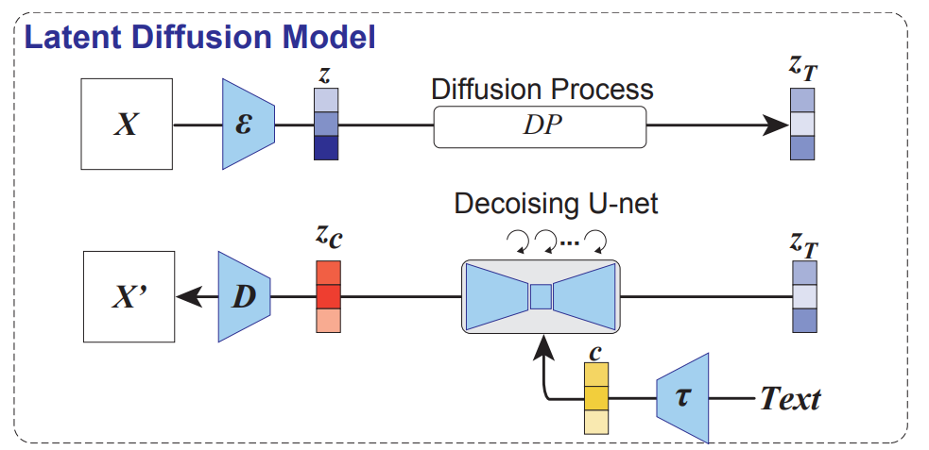
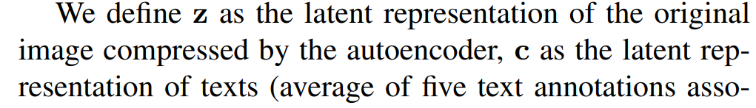
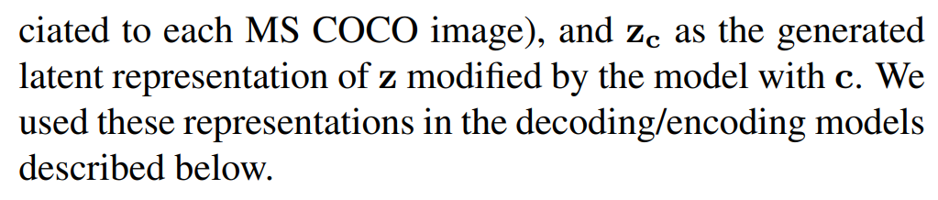
Schematic of LDM used in this study

Slide 10
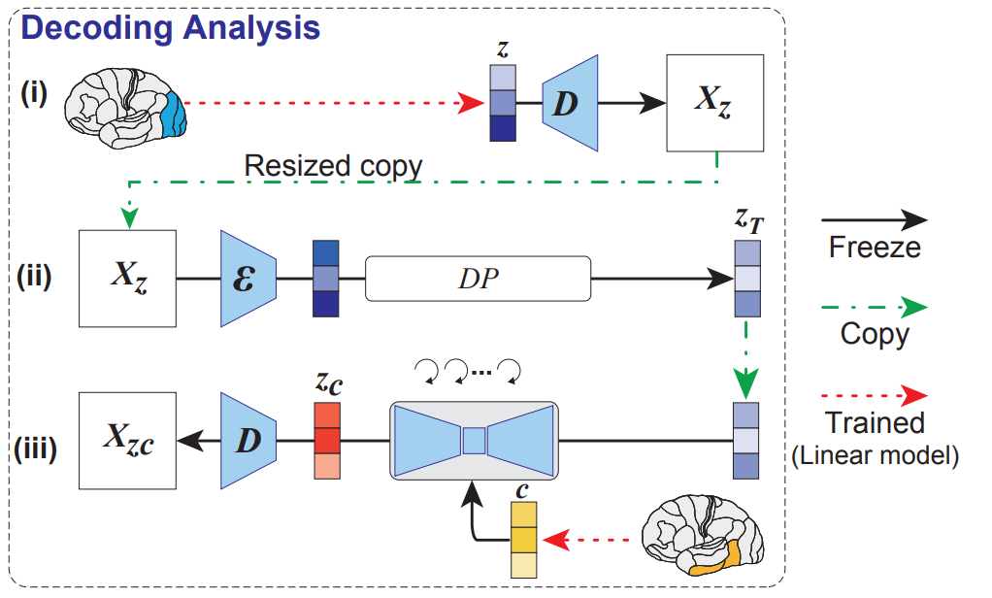
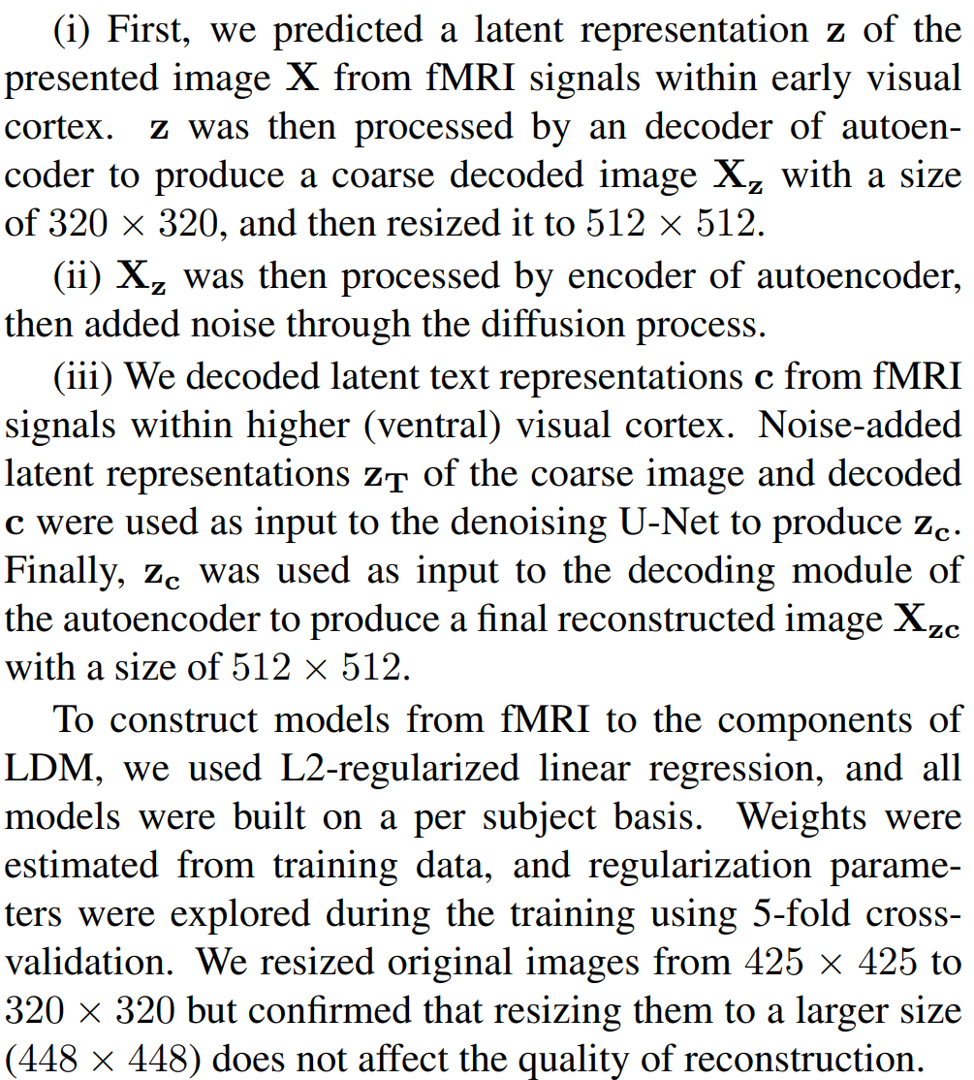
Decoding: reconstructing images from fMRI

Slide 11
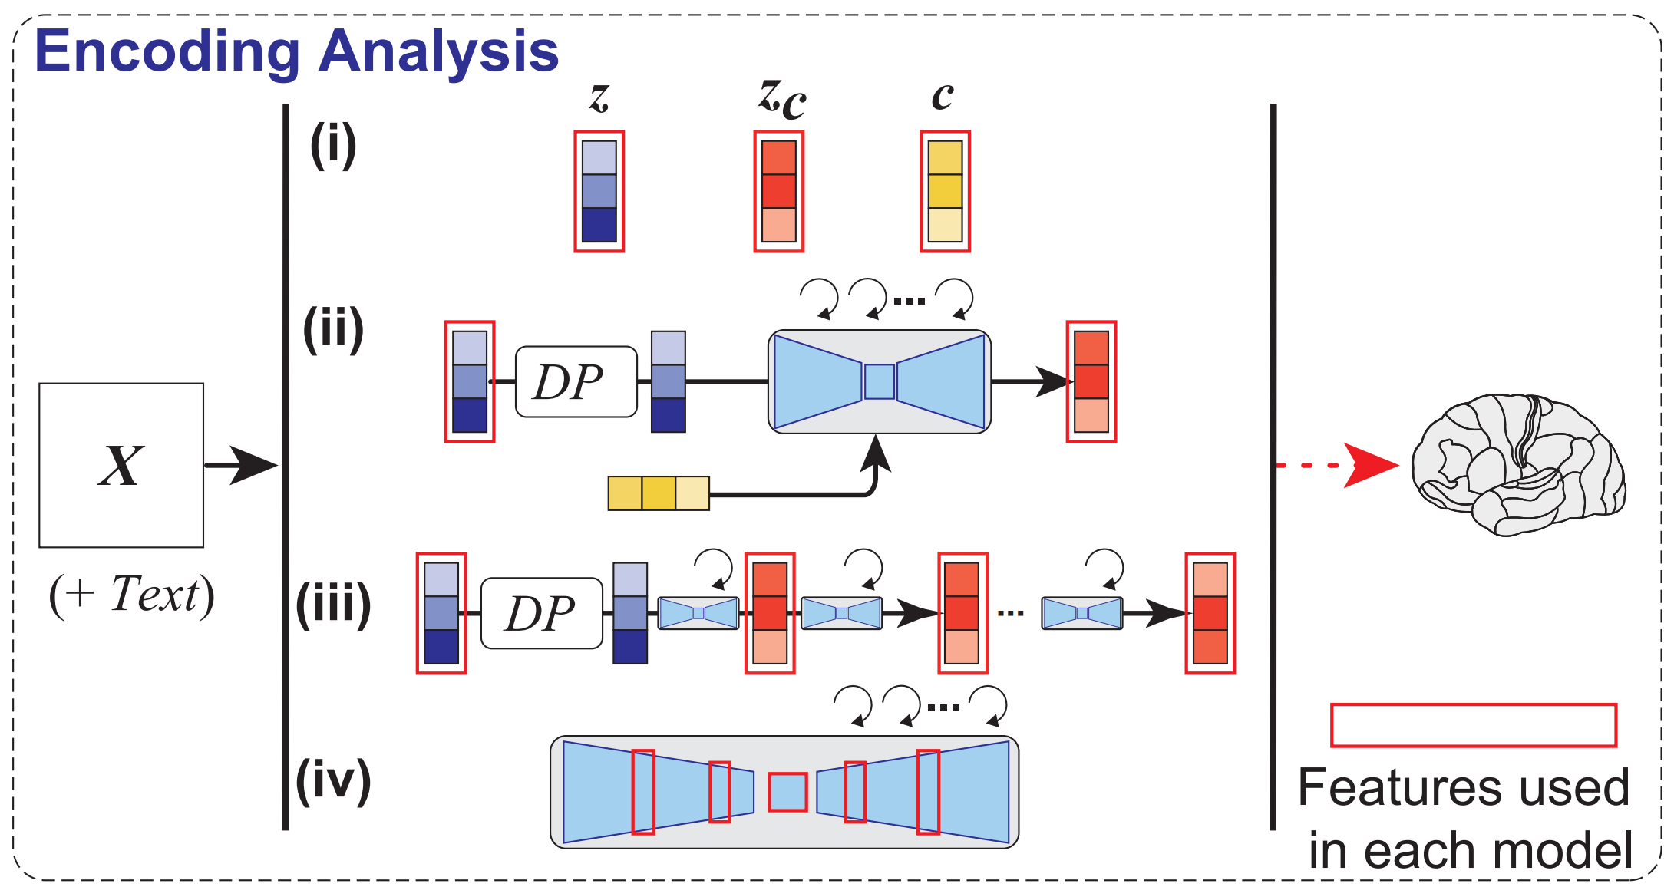
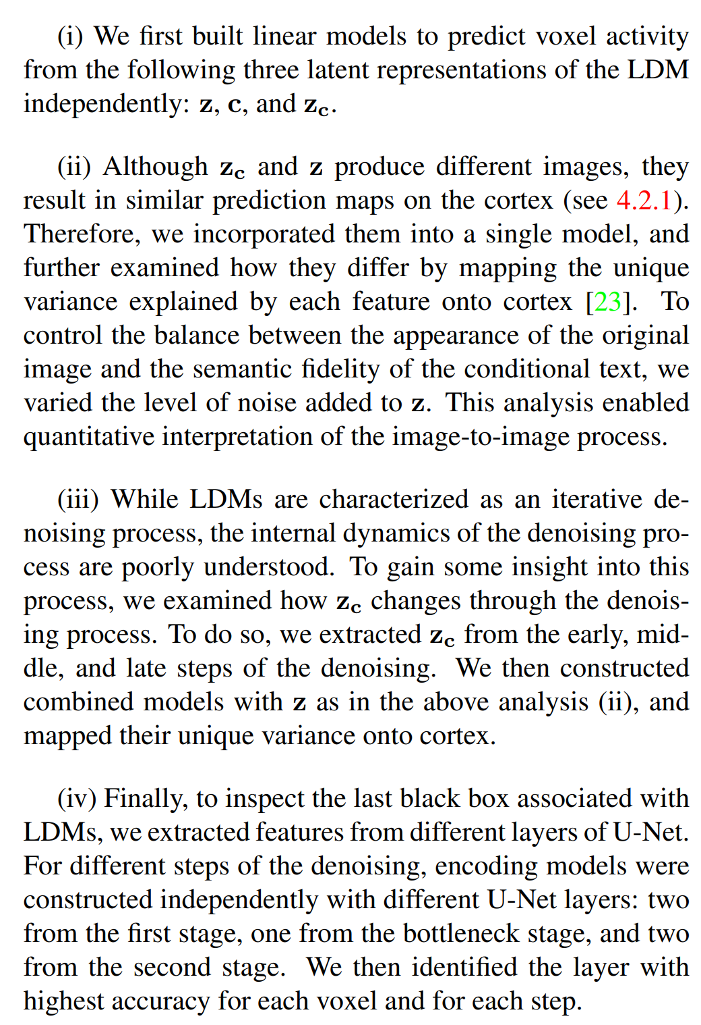
Encoding: Whole-brain Voxel-wise Modeling
Notes:
A voxel is the volume element defined in 3D space. Its dimensions are given by the pixel, together with the thickness of the slice (the measurement along the third axis). Slice thicknesses in clinical MRI vary from a maximum near 5 mm, achieved using 2D multislice imaging, to submillimeter, achieved with 3D scan techniques¹².

Slide 12
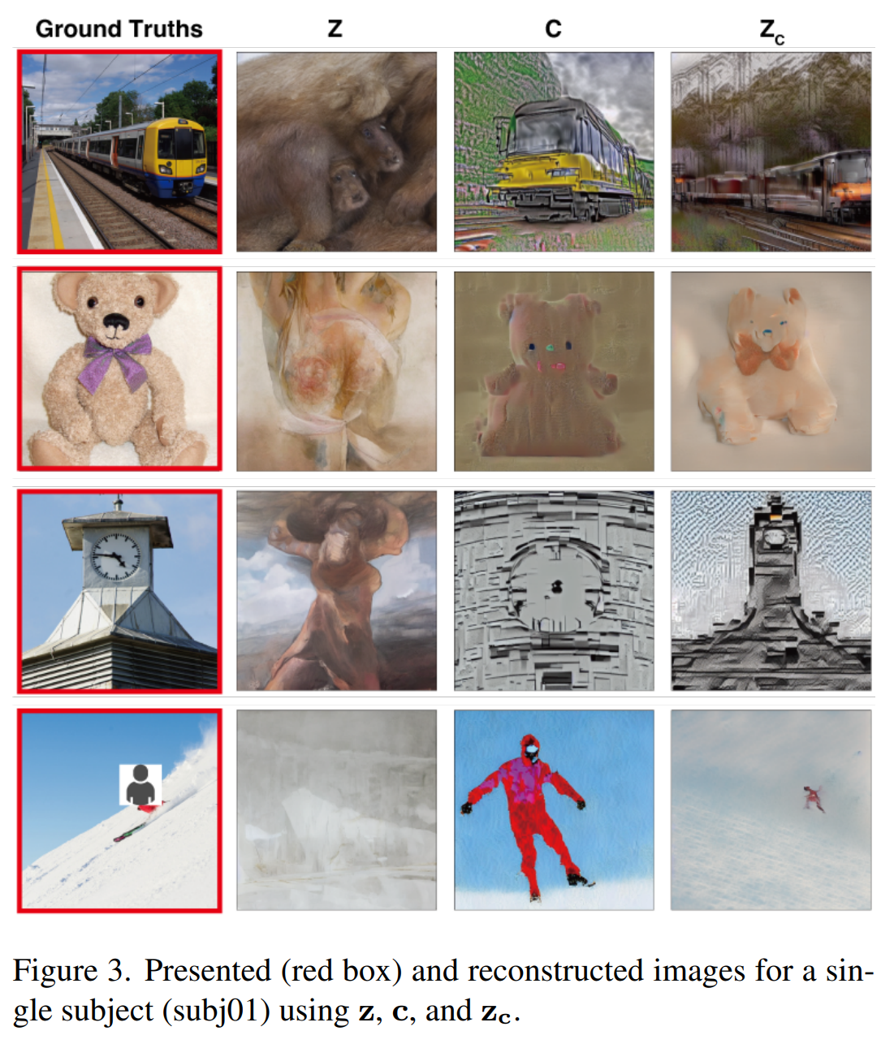
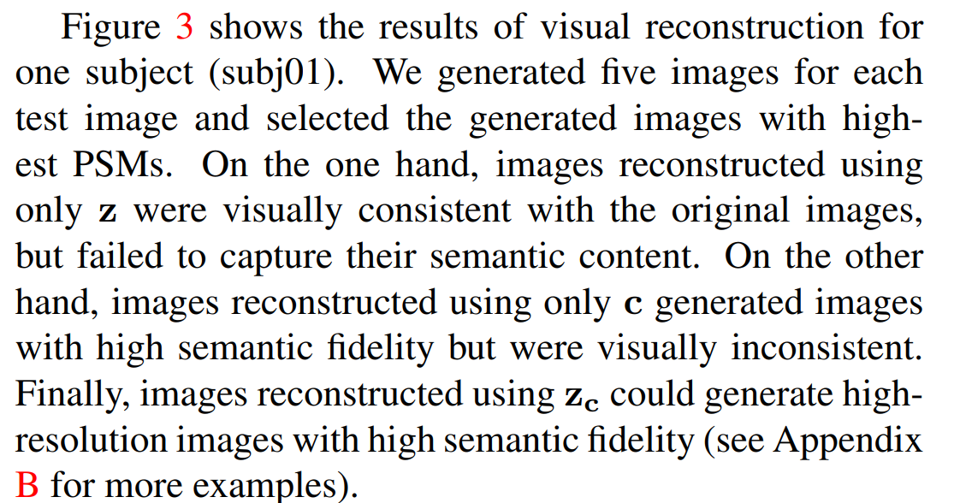
Results - deconstructed

Slide 13
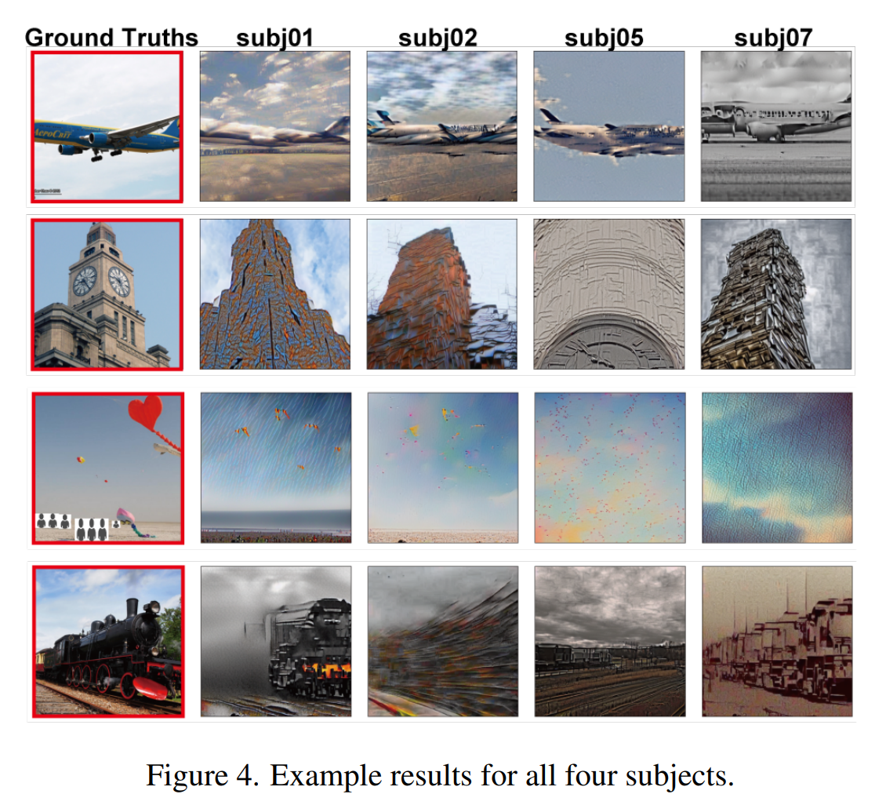
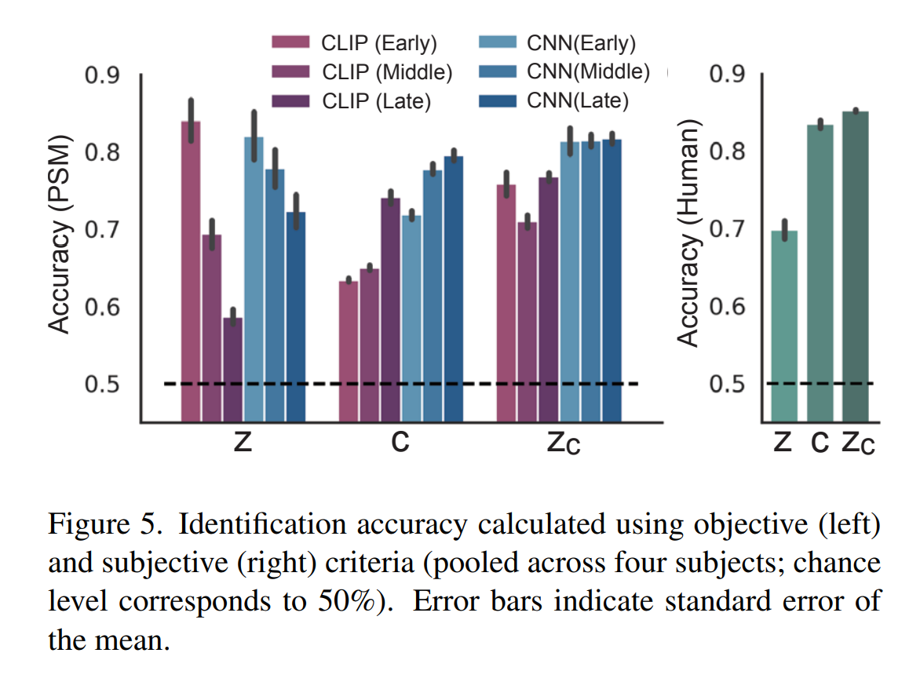
Results across different subjects
Notes:
Perceptual similarity metrics (PSMs) are calculated by using a deep neural network to extract a high-dimensional feature representation for each image. The LPIPS distance between two images is calculated as the mean squared distance between the corresponding feature representations. The final LPIPS score is the value of the LPIPS distance calculated in step 2¹. Other PSMs use similar methods

Slide 14
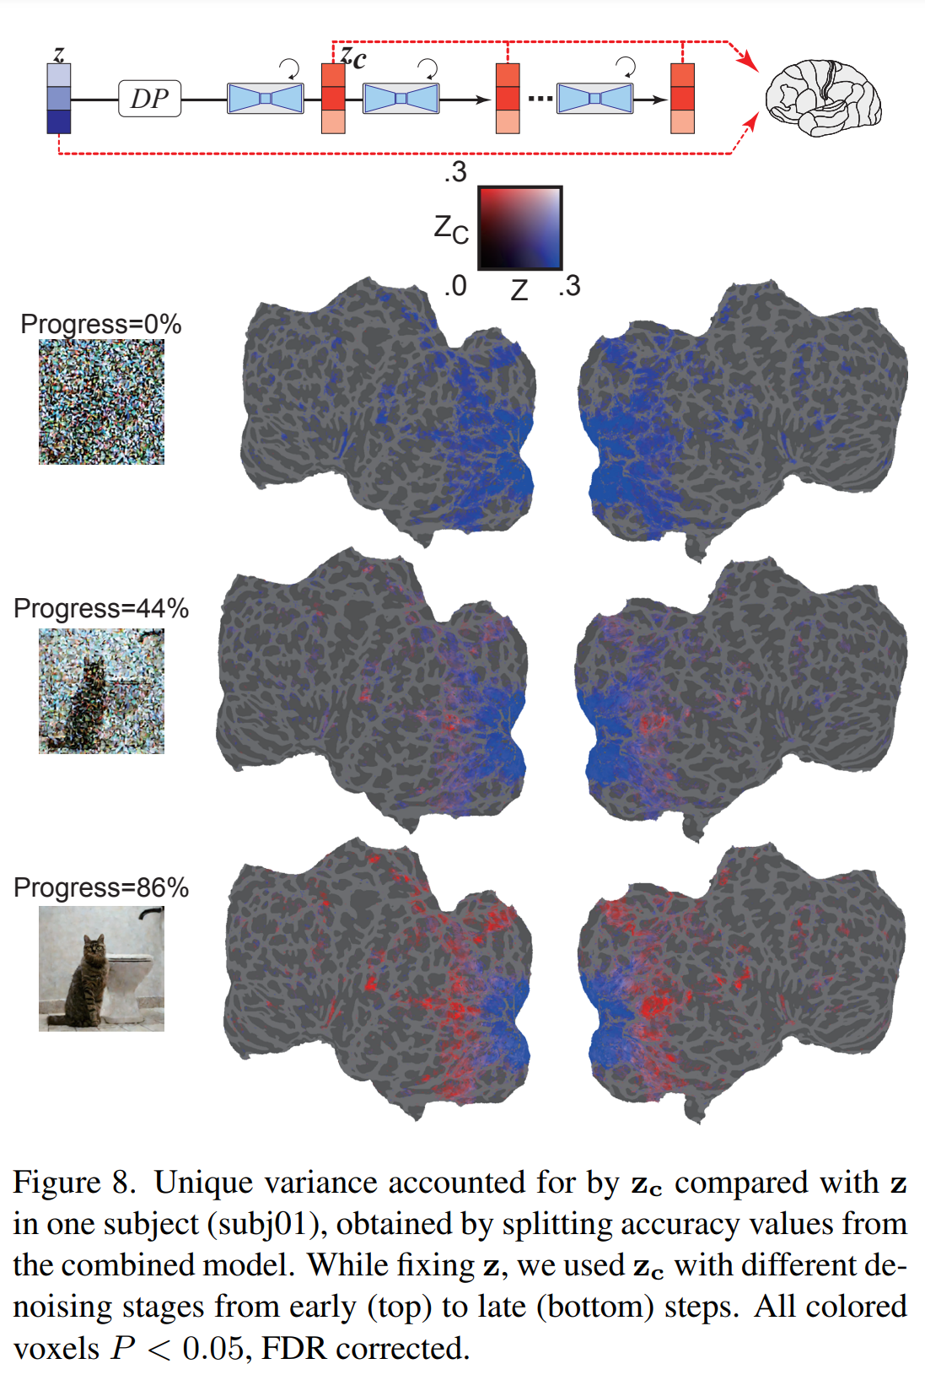
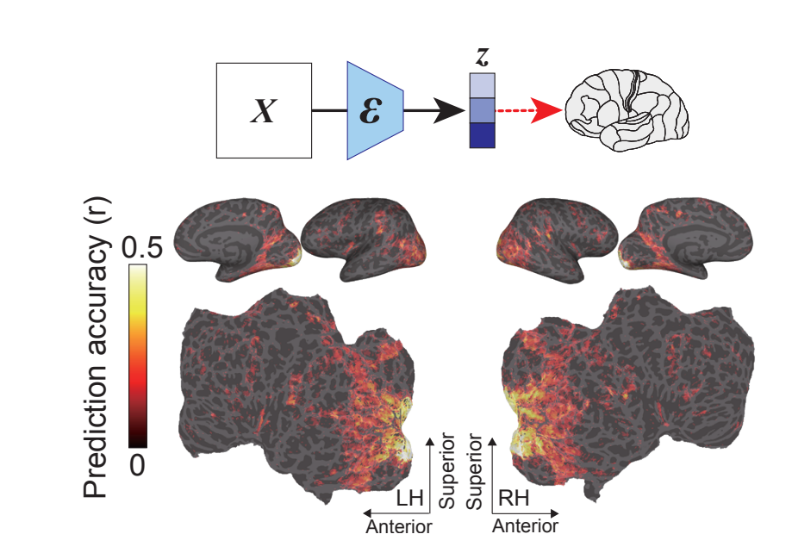
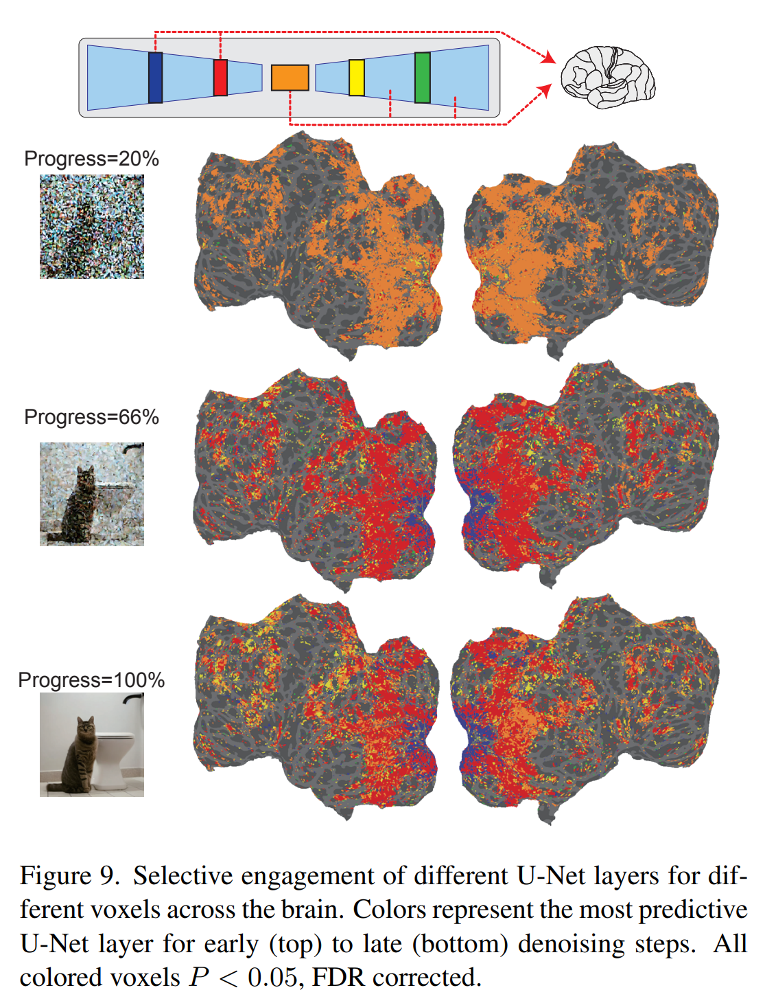
How it maps to the brain
Figure 6. Prediction performance (measured using Pearson’s correlation coefficients) for the voxel-wise encoding model applied to heldout test images in a single subject (subj01), projected onto the inflated (top, lateral and medial views) and flattened cortical surface (bottom, occipital areas are at the center), for both left and right hemispheres. Brain regions with significant accuracy are colored (all colored voxels P < 0.05, FDR corrected)
Notes:
The False Discovery Rate (FDR) procedure is a method of conceptualizing the rate of type I errors in null hypothesis testing when conducting multiple comparisons. FDR-controlling procedures are designed to control the FDR, which is the expected proportion of “discoveries” (rejected null hypotheses) that are false (incorrect rejections of null hypotheses)¹. Controlling for the false discovery rate (FDR) is a way to identify as many significant features as possible while incurring a relatively low proportion of false positives²

Slide 15
Lab
Brain image segmentation ☺

